Slide 1
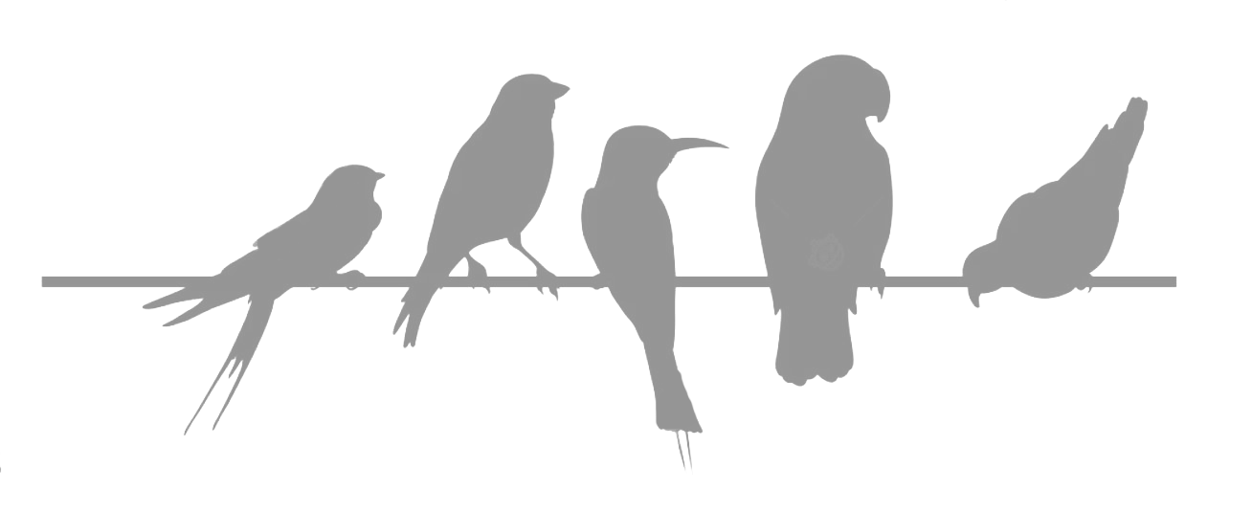
Project for Artificial Intelligence
Student name: Nikos Koutsonikolis
Course name: Intelligence Artificielle – 4TTV417U
University: Université de Bordeaux
Professor in charge: Akka Zemmari - Co-leader of the AI research group at LaBRI
April 2023

Slide 2
Bird Species Classification
Method used: Convolutional Neural Networks – Deep Learning
For our base model we used EfficientNetB0, as an extractor
CNNs are the best way to do deal with image classification

Slide 3
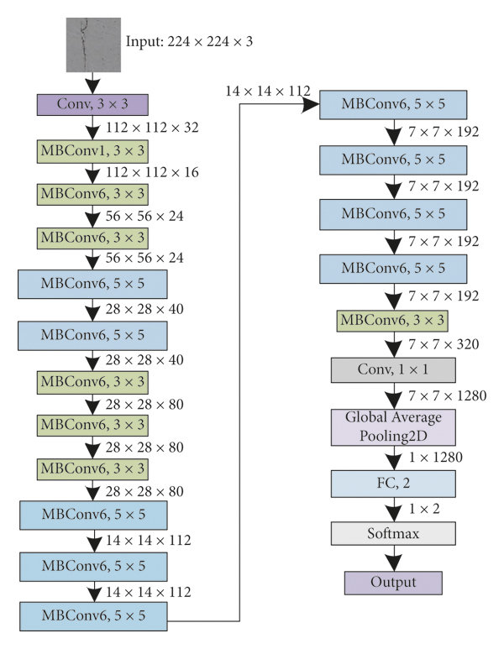

Slide 4
Always step by step
Data preparation – Data Augmentation
Model implementation
Model training
Plotting Accuracy/Loss Diagrams
Model testing and predicting on new data

Slide 5
Is it the best way though?
In general Deep Learning is more efficient for image classification problems than any other method, as long as we have enough data to train our models on. In this occasion, we‘ll get the best accuracies. On the other hand, the training process will demand big amount of time/resources.

